Slide 1
Effective Population Size
Heath Blackmon
Guest Lecture - Population Genetics

Slide 2
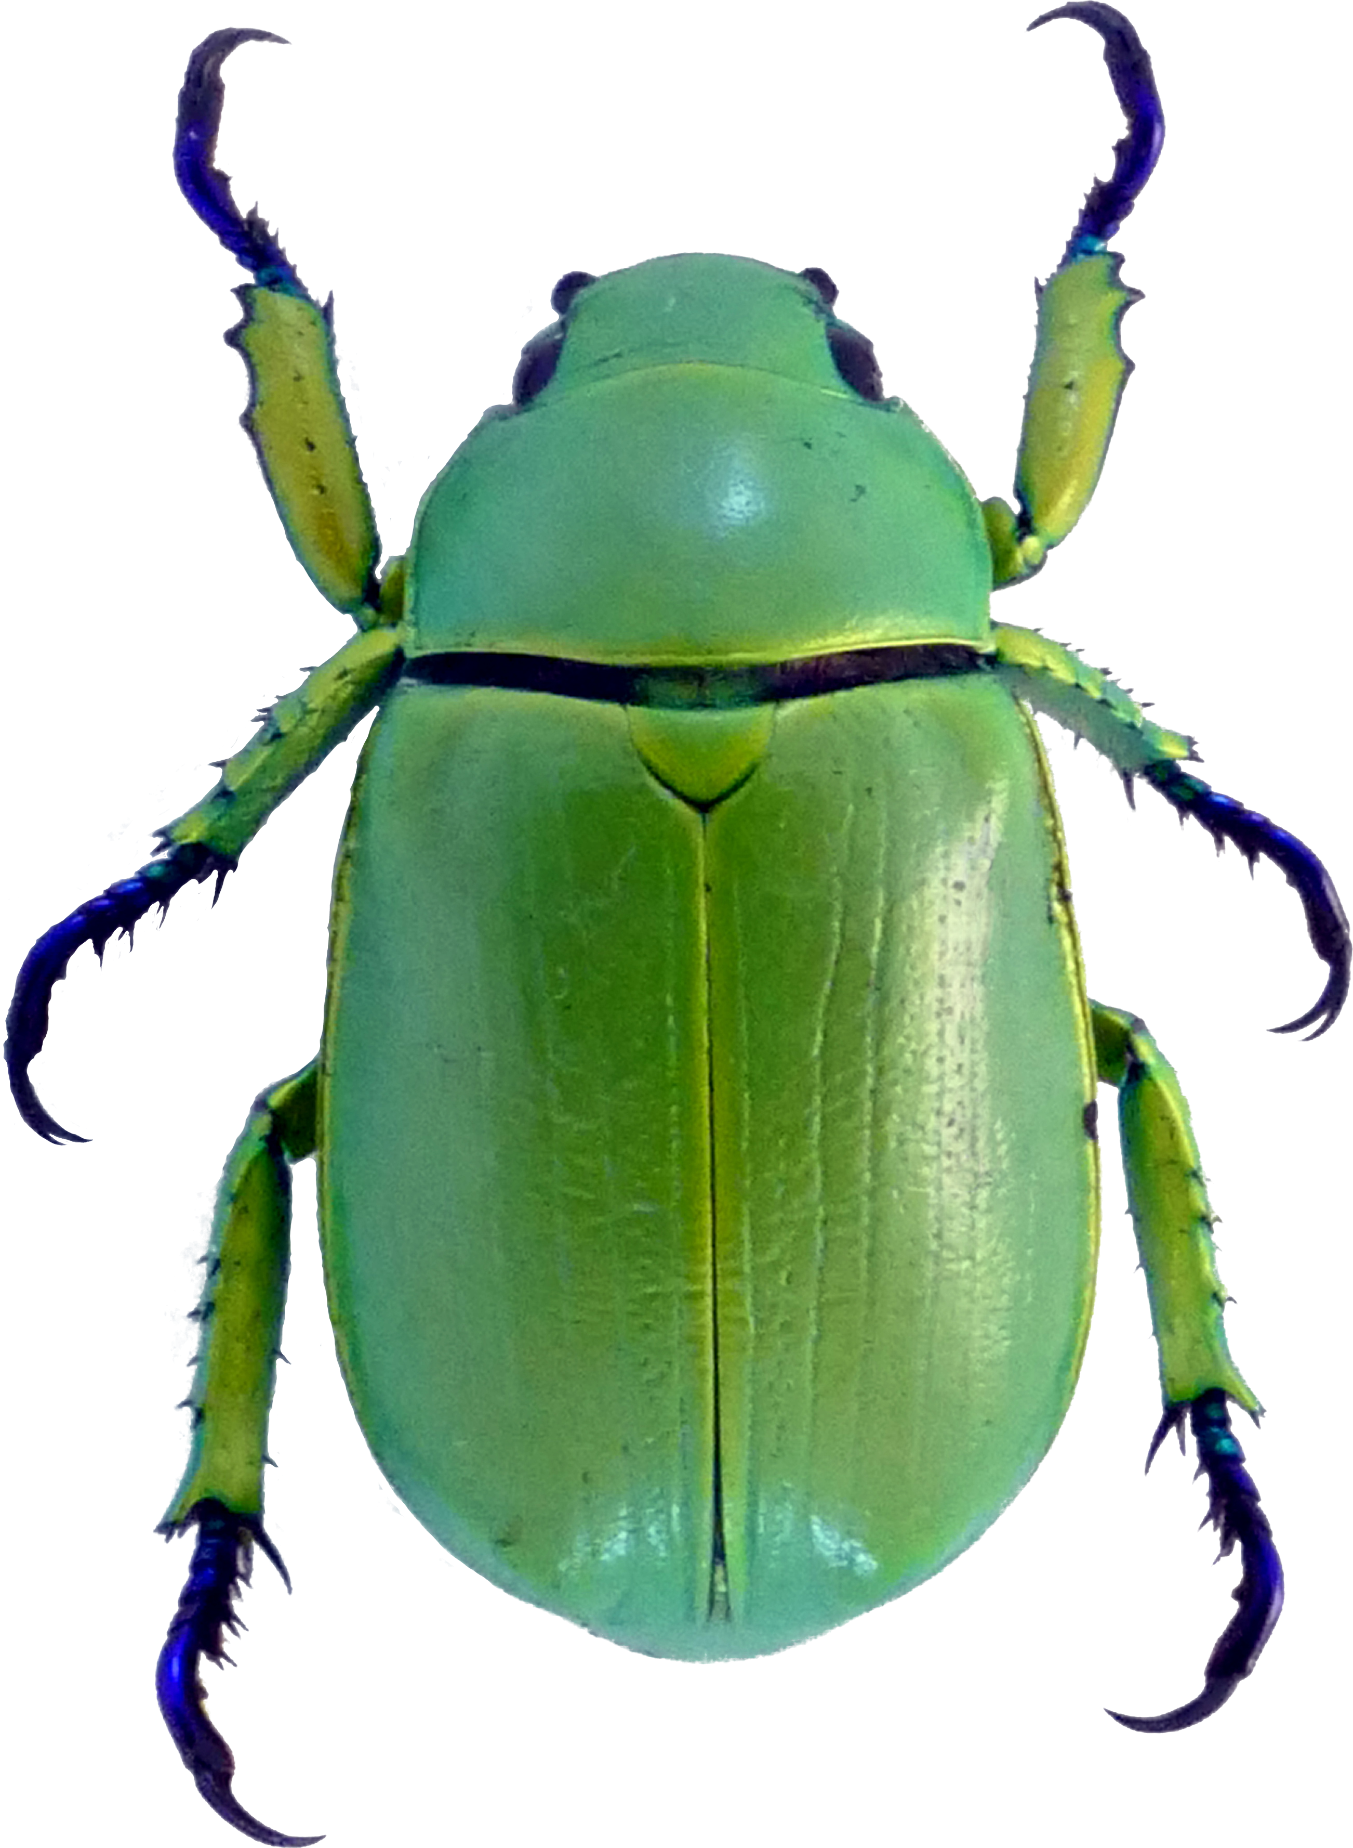
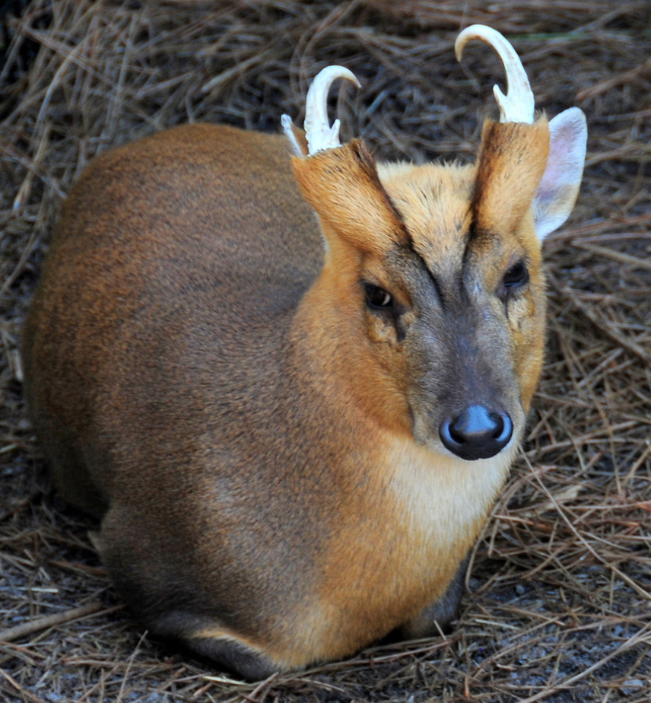
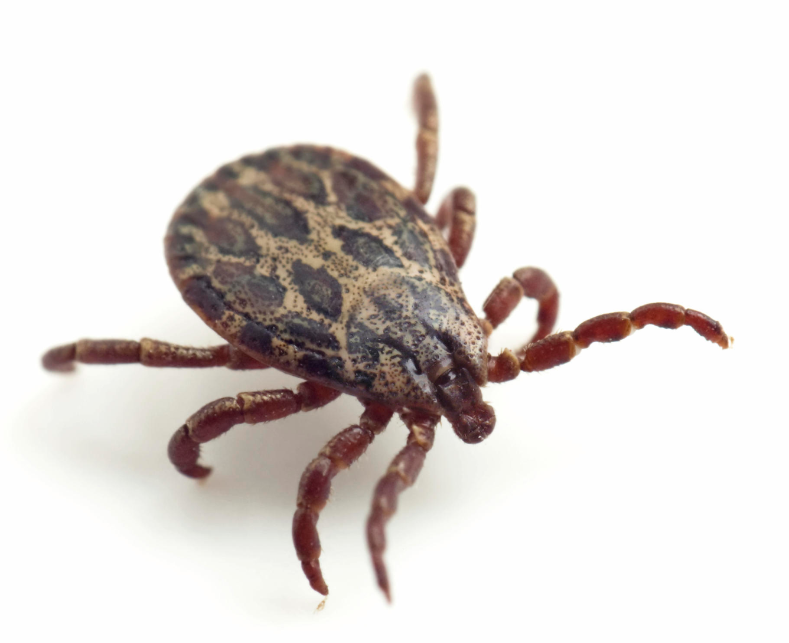
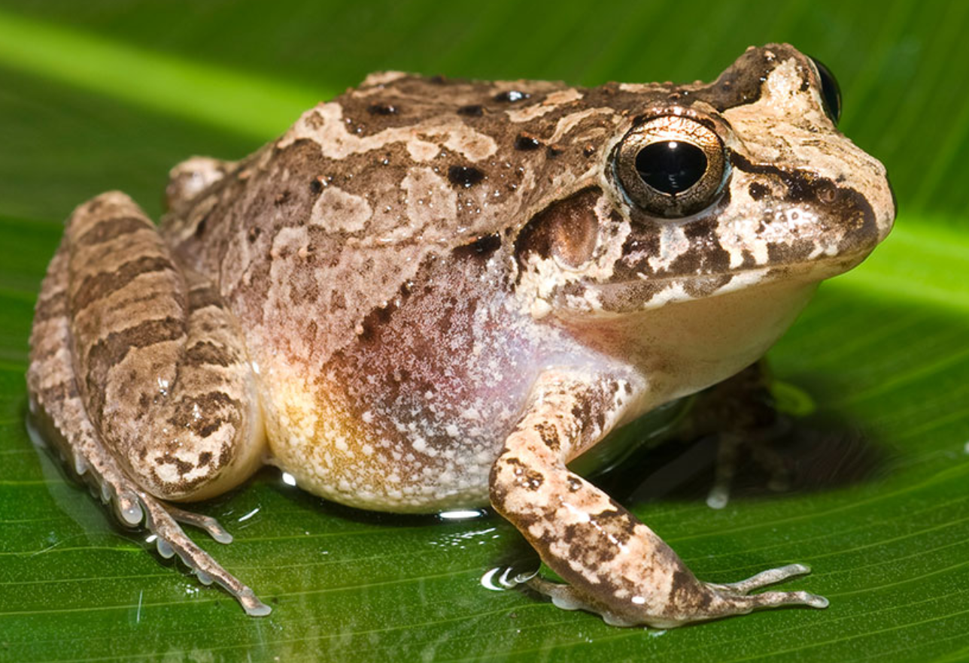
Evolutionary Biology
Genomics
Analyzing whole genome data to understand what and how genes impact traits
Trait
Evolution
Genetics
Studying the way traits are inherited
Theory
Applying math to ask how traits can evolve

Slide 3
Why does effective population size matter to me?
The effective population size determines the balance between drift and selection and by extension the fate of new mutations.
Are all mutations the same?

Slide 4
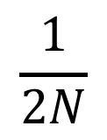
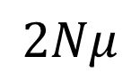
Neutral mutations are not impacted by populations size
Mutations are roughly neutral
$$\frac{1}{2N}$$
Probability that a new mutation will fix in the population is just its current frequency
simulation
-1 0 1
fitness
How many mutations occur
$$2Nμ$$
Notes:
one less pop

Slide 5
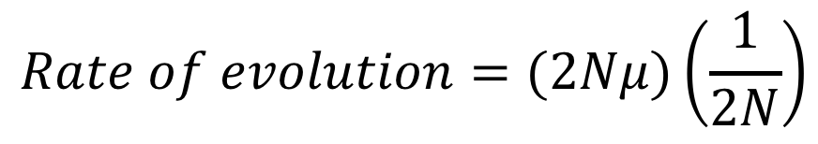
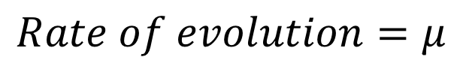
Neutral mutations are not impacted by populations size
Mutations are roughly neutral
-1 0 1
fitness
$$Rate of evolution=(2Nμ)\left(\frac{1}{2N}\right)$$
$$Rate of evolution=μ$$
Rate of evolution
Small Large
Population size
Notes:
one less pop

Slide 6
Population size has different impacts on deleterious and beneficial mutations
Mutations are deleterious
Mutations are beneficial
-1 0 1
fitness
-1 0 1
fitness
Rate of evolution
Rate of evolution
Small Large
Population size
Small Large
Population size
Notes:
Ok the first step in doing this then is to collect a bunch of data on chromosome number

Slide 7
Chromosome number in beetles (observational and comparative)
What is the fitness of mutations that change chromosome number?
Sexual antagonistic mutations (theory and experimental)
Can we find mutations that impact only one sex or have different fitness in the sexes?

Slide 8
Some traits are associated with population size
High N_{e} | Low N_{e}
Winged | Wingless
Outbreeding | Sibmating
Generalist | Specialist
Continental Distribution | Island Distribution
Wright 1969
Petitpierre 1987
Notes:
So lets look at what happens when we apply this to some clades in our dataset

Slide 9
Assigning population sizes based on traits
A composite trait for N_{e}
Initial score: 4
- wingless
- inbreeding
- monophagous
- Island distribution
Composite score
•
•
•
 |  | Genus | Sum | N_{e}
Adephaga |  | Bembidion | 4 | High
 |  | Cicindela | 4 | High
 |  | Harpalus | 4 | High
 |  | Pterostichus | 3 | Medium
 |  | Calathus | 2 | Low
Polyphaga |  | Diabrotica | 4 | High
 |  | Ips | 3 | Medium
 |  | Pimelia | 3 | Medium
 |  | Chrysolina | 2 | Low
 |  | Cyrtonus | 2 | Low
 |  | Dendroctonus | 2 | Low
 |  | Timarcha | 2 | Low
Low N_{e}
Medium N_{e}
High N_{e}
What groups should show the most changes in chromosome number if changes are neutral, deleterious, or beneficial?
Notes:
Now lets compare the rates in each of these genera with each other

Slide 10
Chromosome number evolves faster in clades with small N_{e}
•
•
•
Low N_{e}
Medium N_{e}
High N_{e}
Notes:
So what the heck is going on with calathus this could be bad

Slide 11
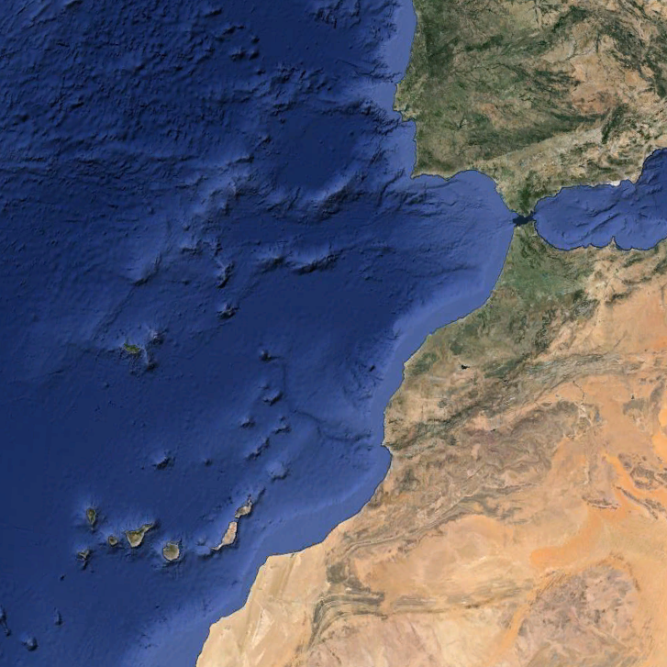
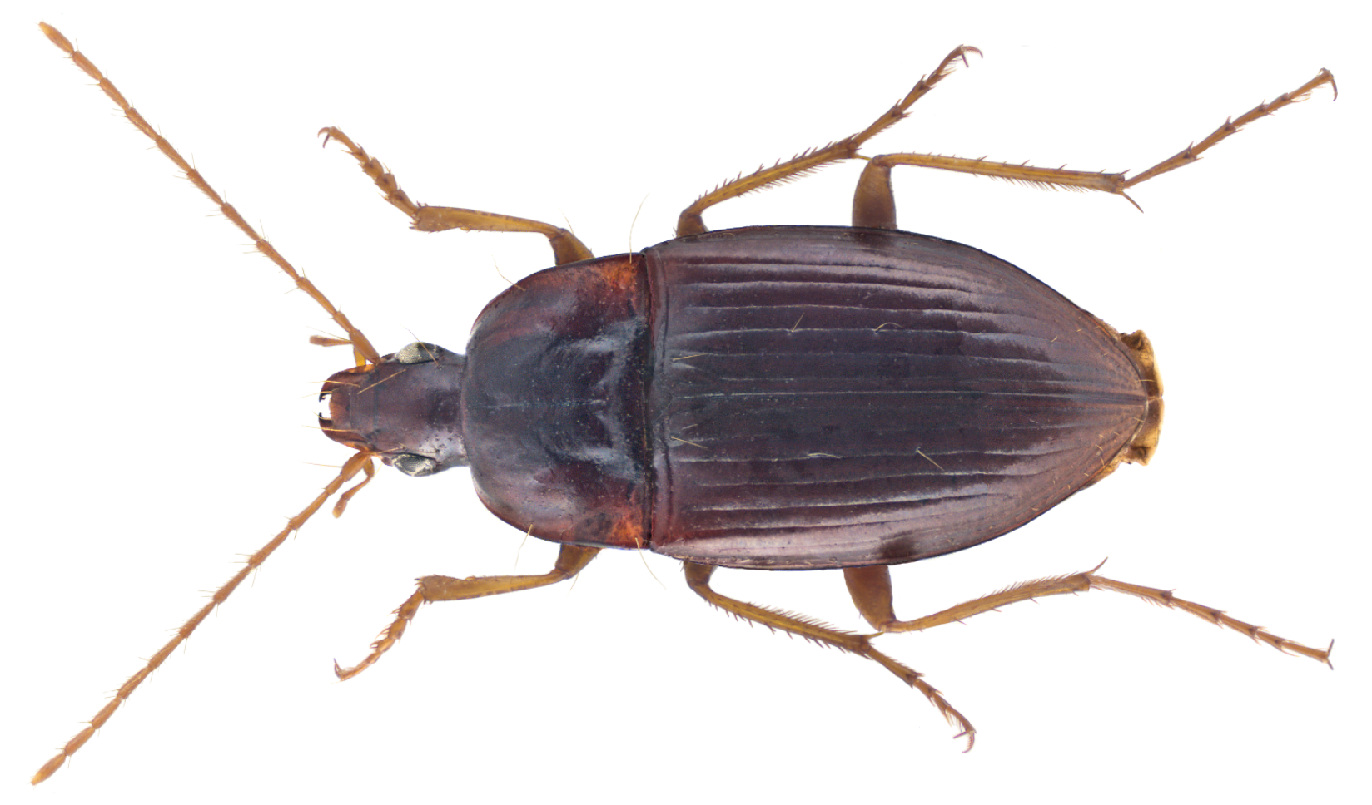
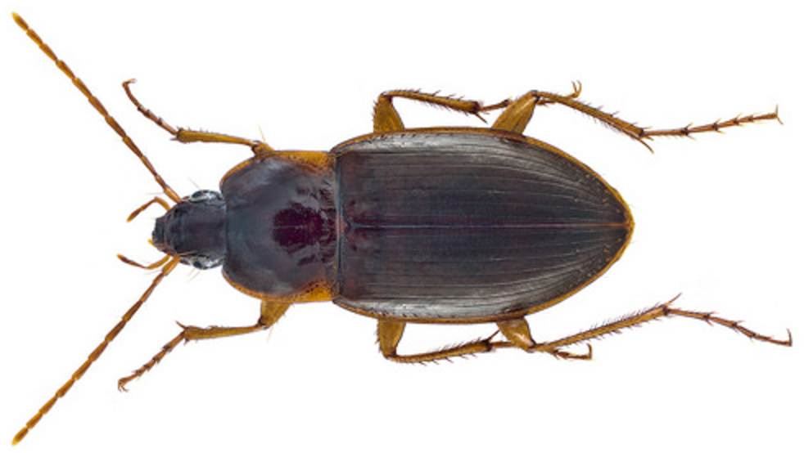
Species isolated as small populations change the most
Notes:
Ok this is great this is a nice example of looking across a large phylogeny and seeing the same affect again and again lets dive in though and look at a much larger slice of one part of the tree

Slide 12
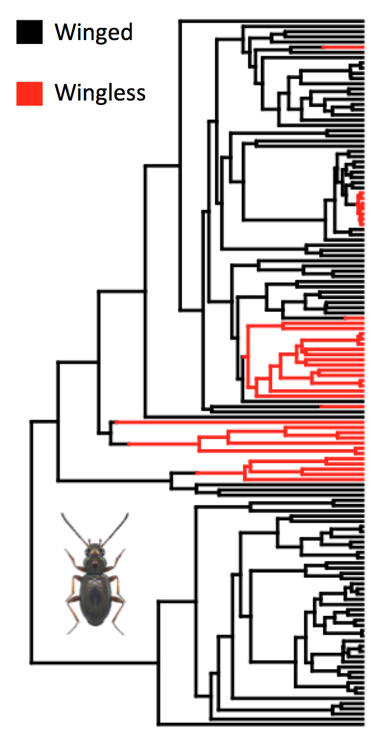
Wingless species have higher rates of evolution
Which group do we expect to evolve faster?
Notes:
Label arrows so match next side

Slide 13
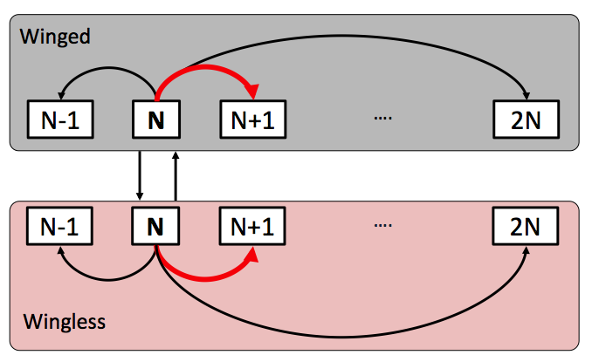
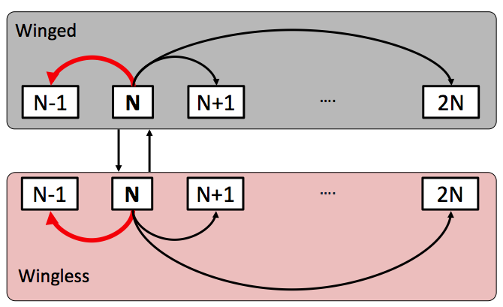
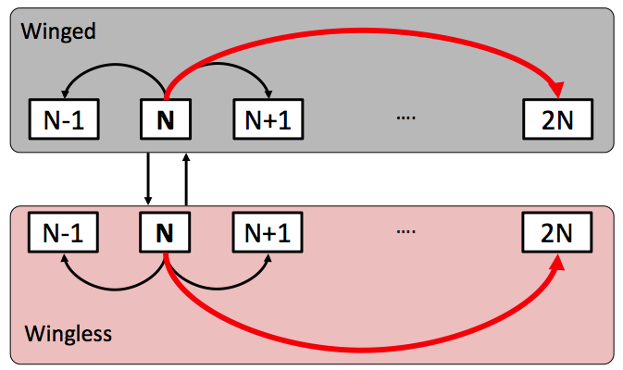
Wingless species have higher rates of evolution
Fission
Fusion
Polyploidy
Notes:
So we’ve now switched to a more biologically realistic model and we see this same pattern repeated

Slide 14
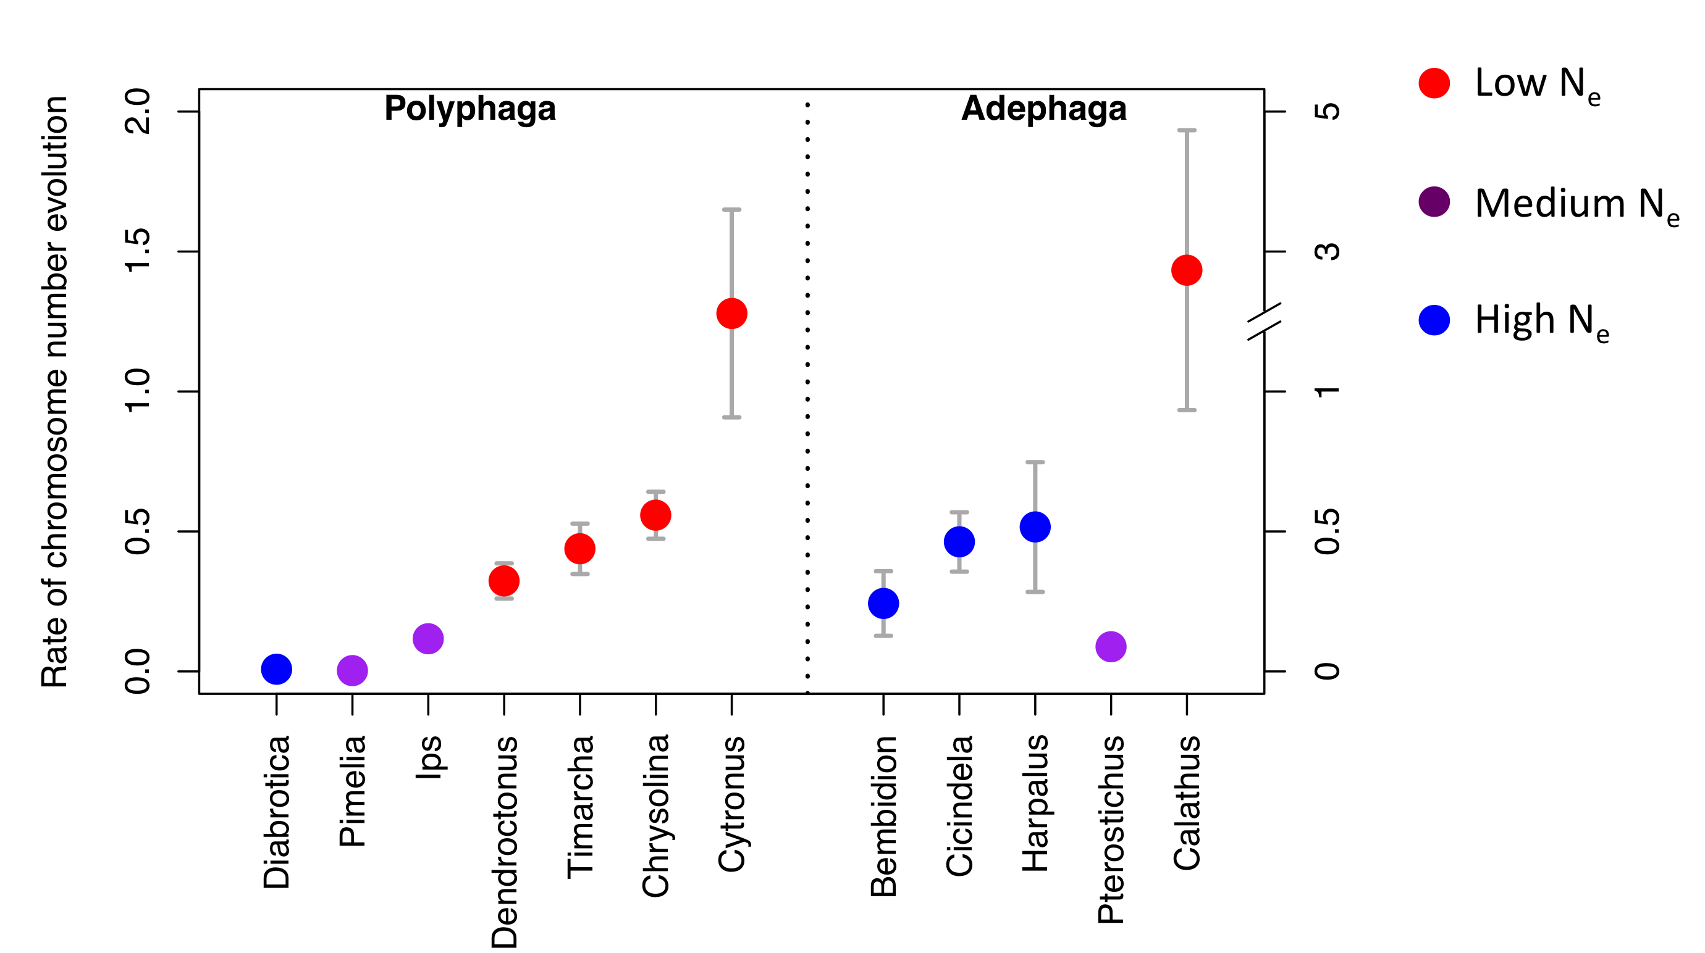
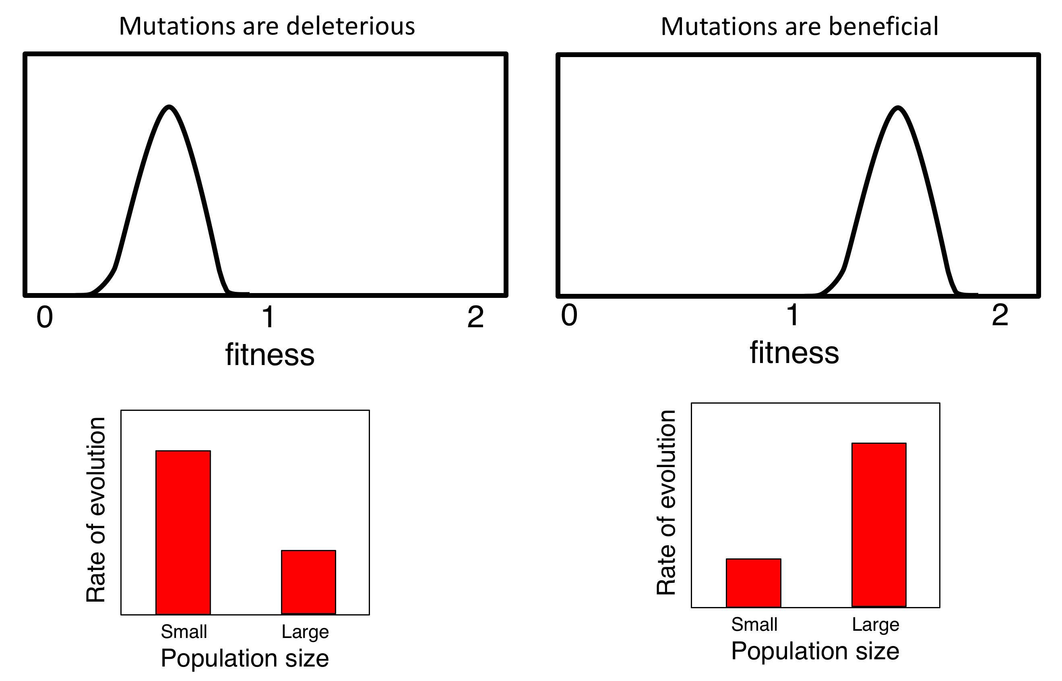
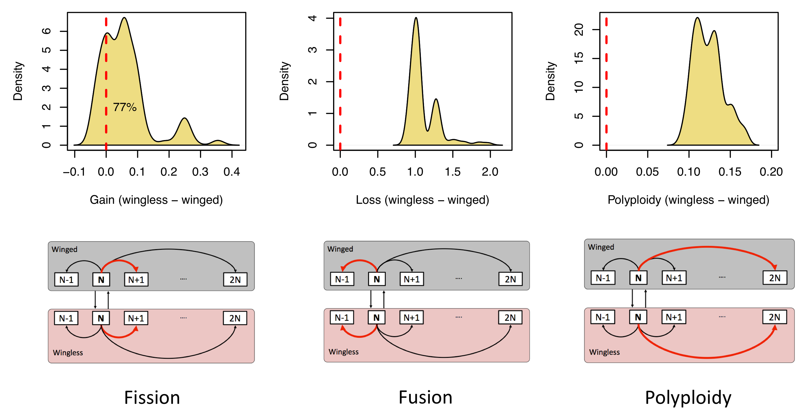
What is the fitness of mutations that change chromosome number?
Notes:
So lets take a moment to look at the patterns of chromosome number that we see across the tree of life.

Slide 15
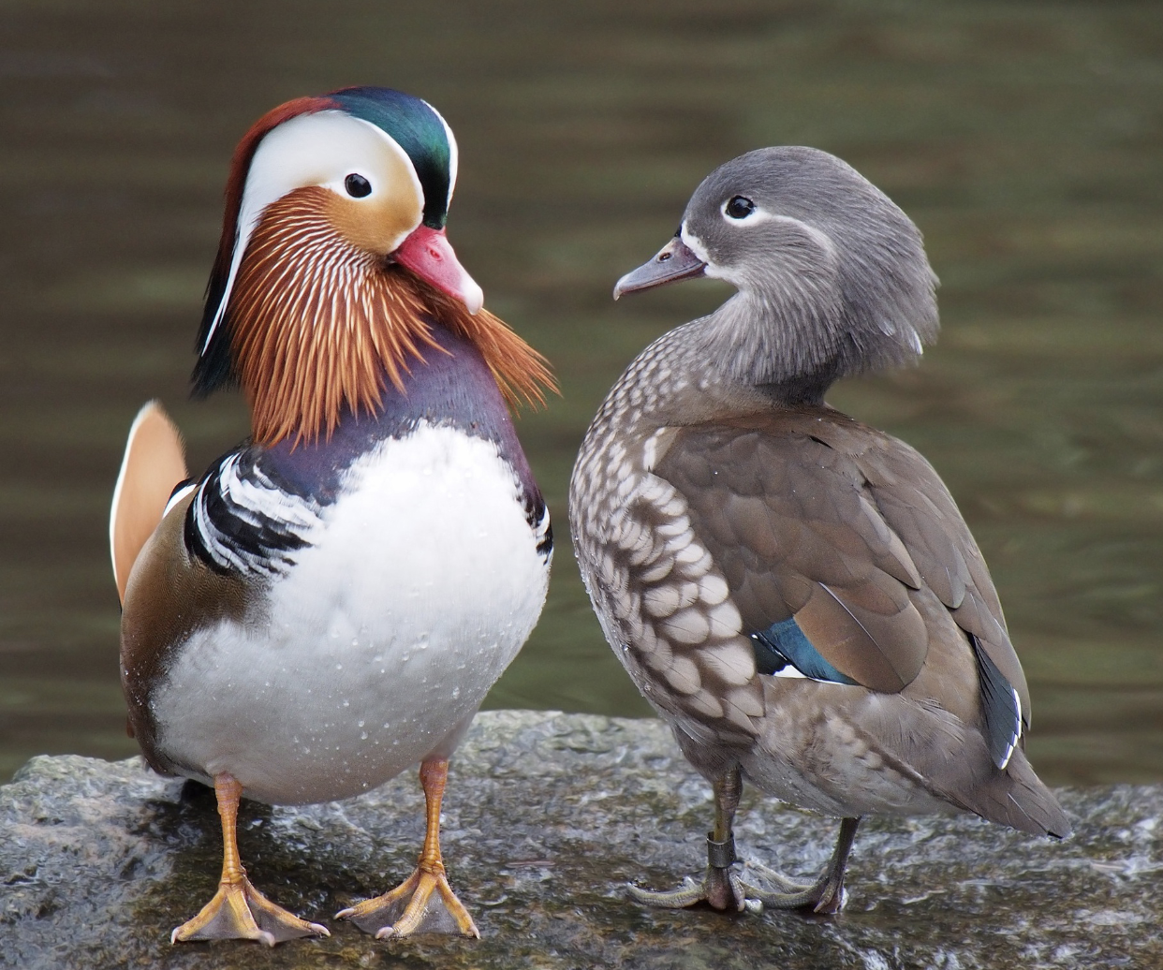
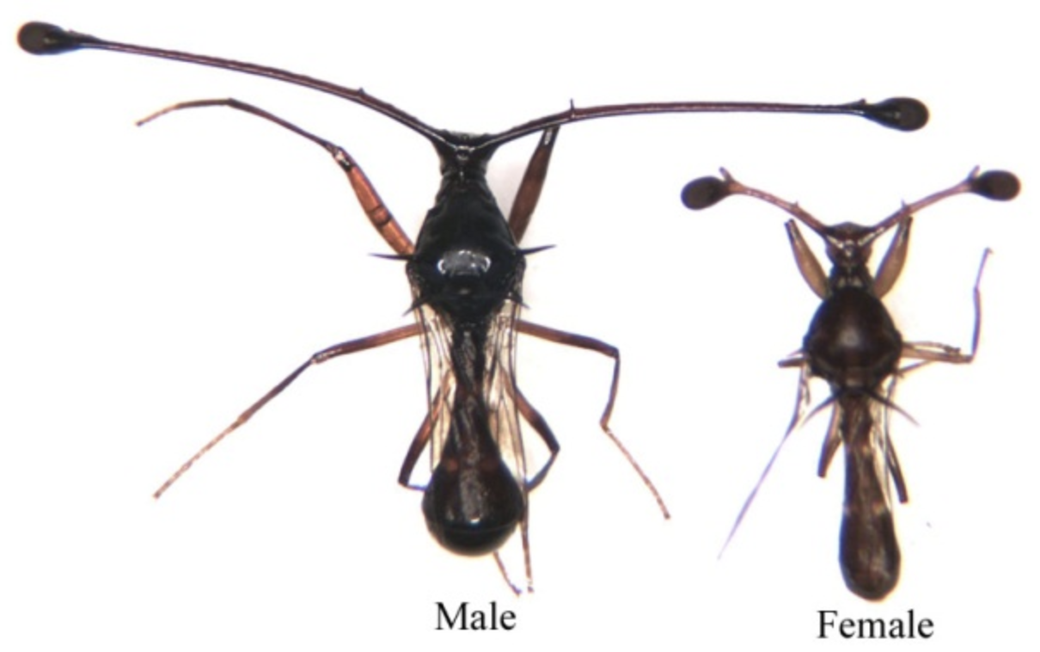
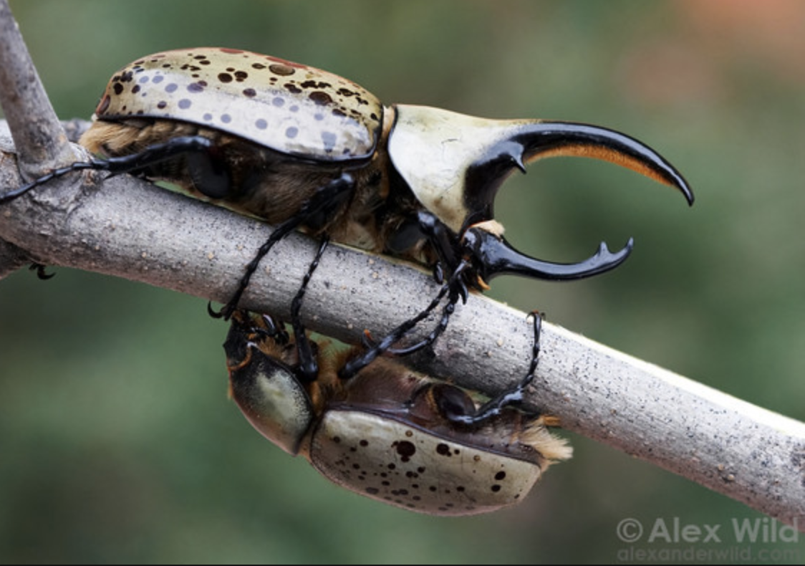
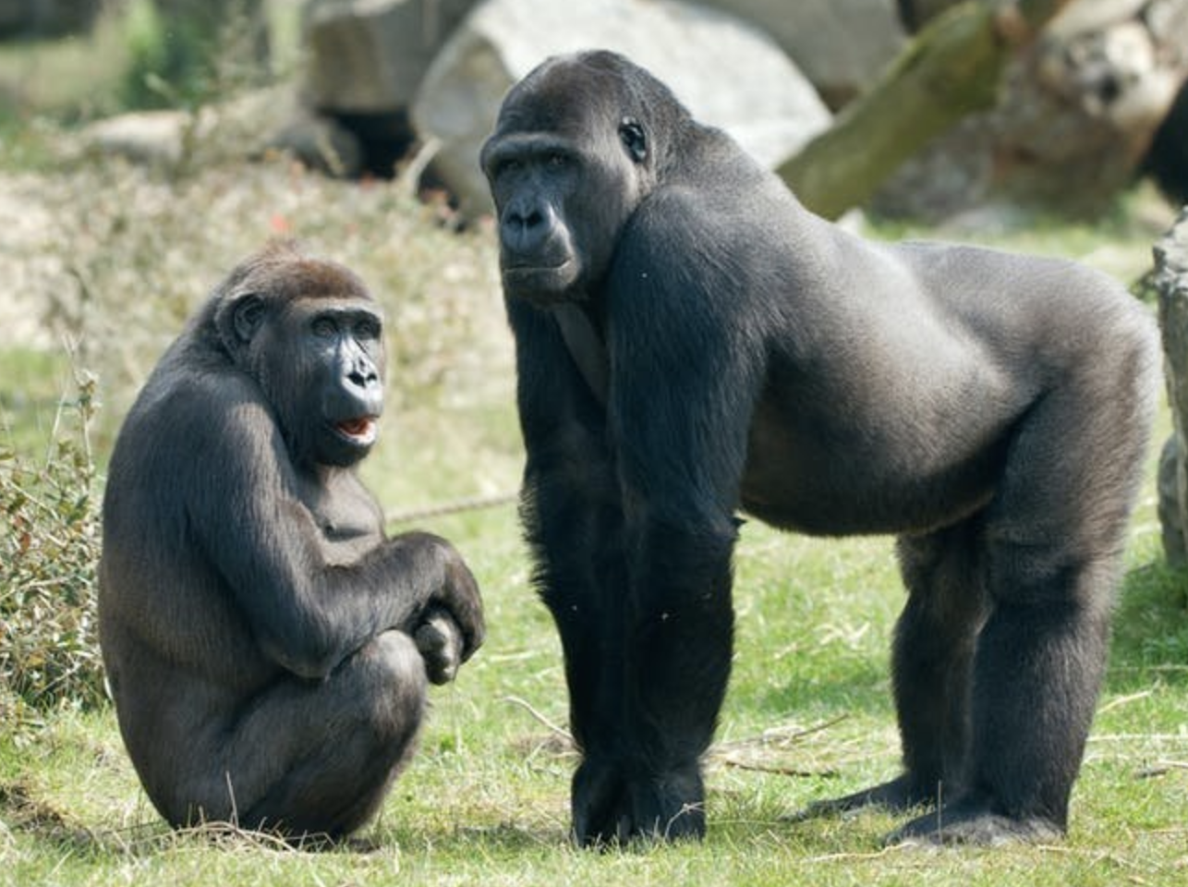
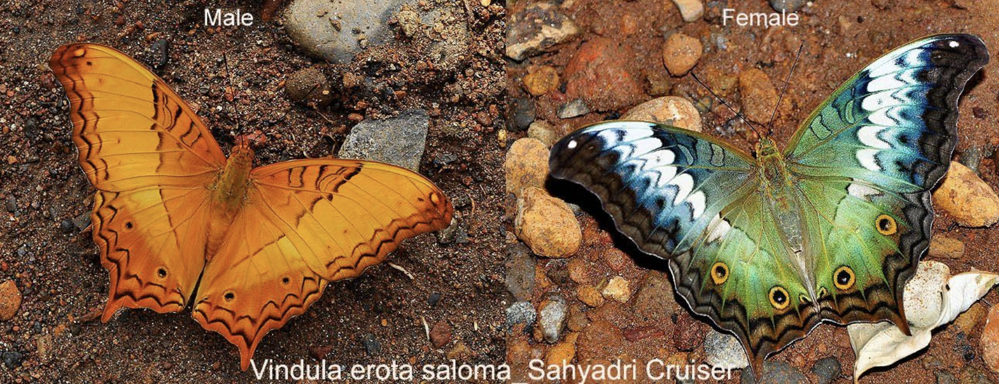
Notes:
So lets take a moment to look at the patterns of chromosome number that we see across the tree of life.

Slide 16
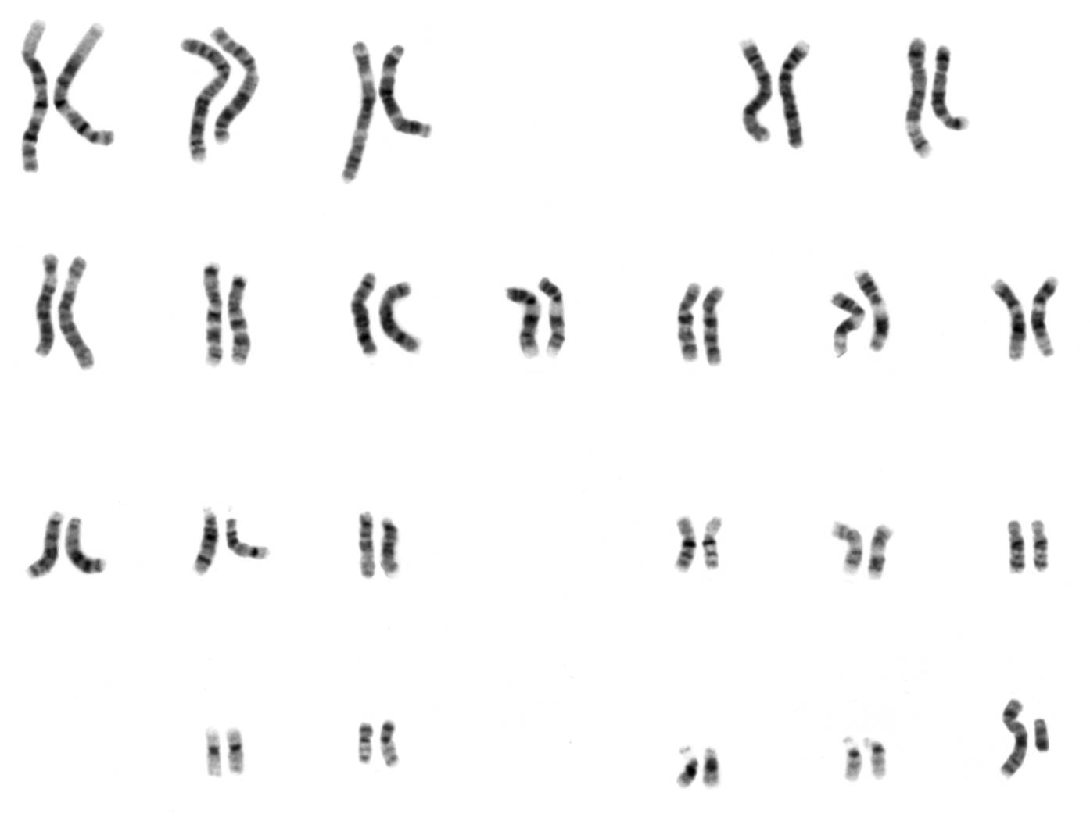
Notes:
So lets take a moment to look at the patterns of chromosome number that we see across the tree of life.

Slide 17
Sexual antagonism is fundamental to our understanding of sex chromosomes
Recombining region
Male determining allele
Sexually antagonistic allele
inversion
Non-recombining region
inversion
What are these sexually antagonistic alleles?
PAR Pseudoautosomal Region
Autosomes
X Y
X Y
X Y
Notes:
What I want to do for a few minutes though is show you some other empirical observations that I think make it quite obvious what is missing from this canonical model.

Slide 18

We often think of populations as having equal numbers of males and females.
When they don’t we can even calculate the effective population size due to difference in the number of the two sexes.

Slide 19
What would happen to mutations that benefited males and females differently if most of the population was female/male?

Slide 20

We set out to answer this question with a population genetic model.
X S.A. Mutation
Sex Chromosomes
Y S.A. Mutation
S.A. Mutation
Amy Shum and David Gafford-Gaby
Autosomes
S.A. Mutation

Slide 21
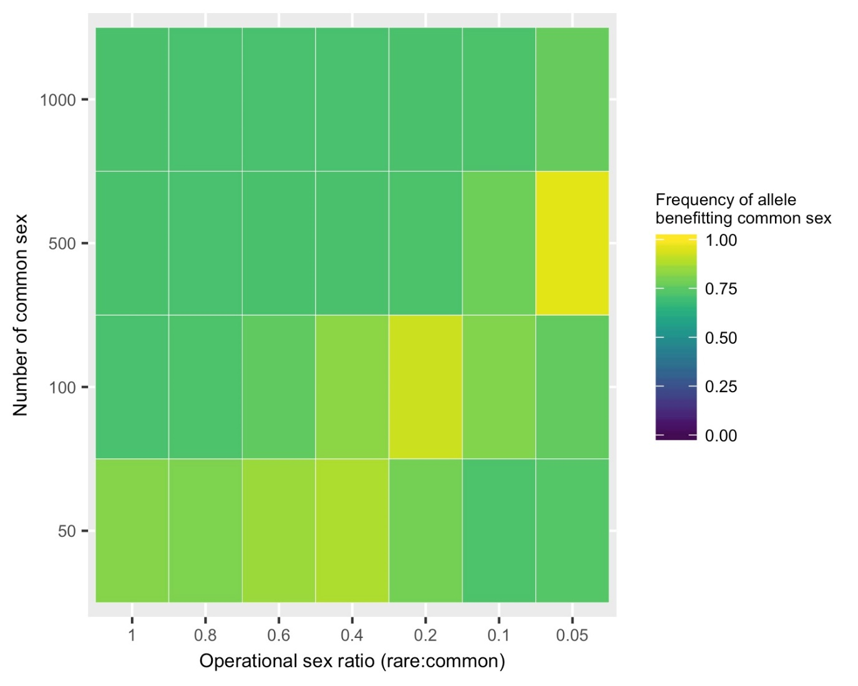
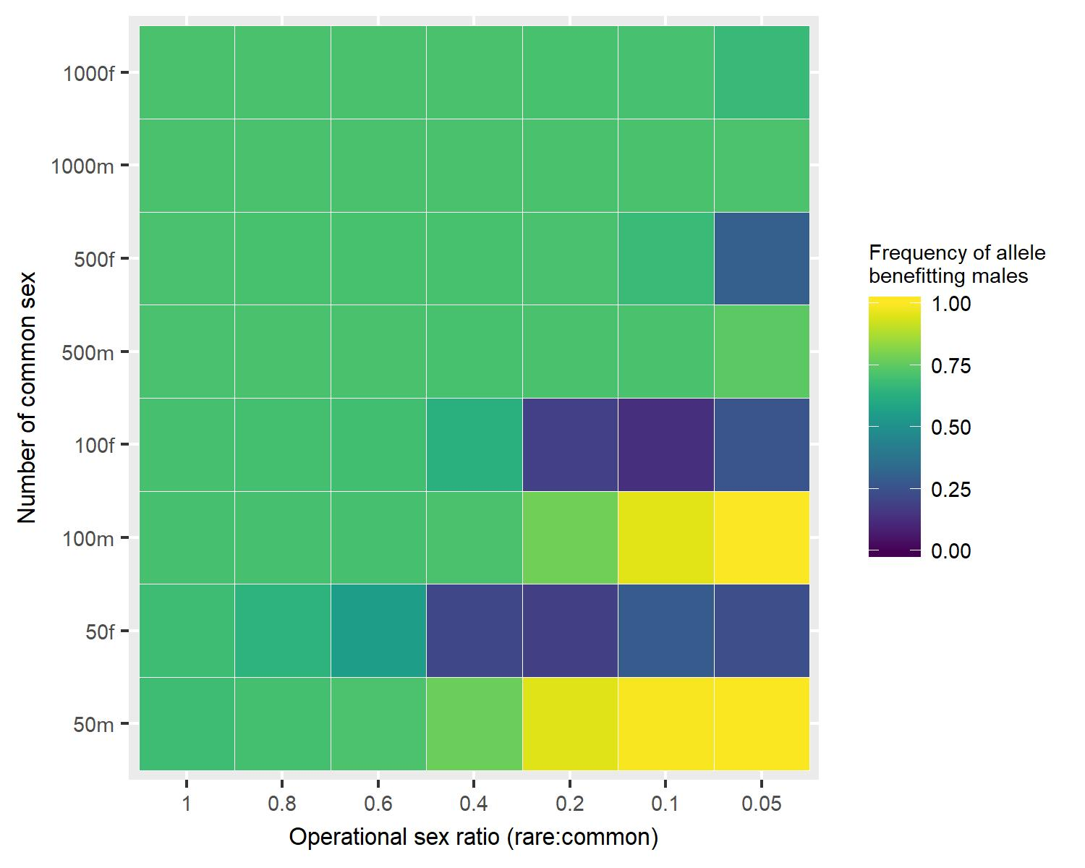
Biasing sex ratio in small populations concentrates selection in one sex
Autosome
Y chromosome

Slide 22
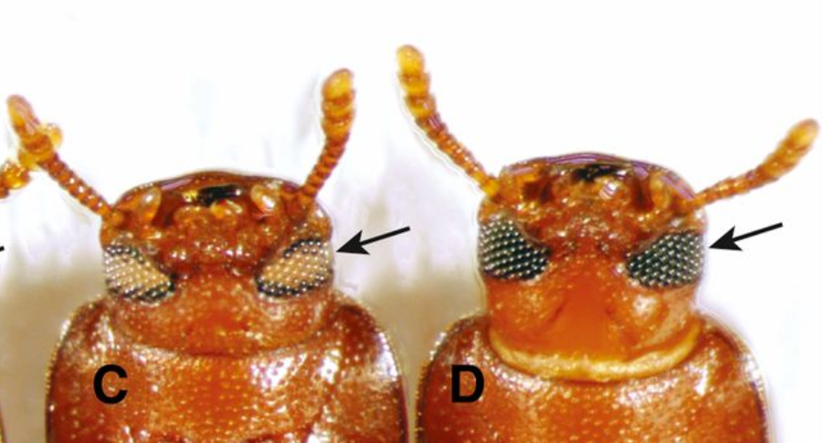
Creation of pseudo Y and W chromosomes using mutants and biased operational sex ratio
T. Castaneum Genome 190 Mbp
wht
30
15
0
ptl
jet
cst
sqt
prl
hzl
X 2 3 4 5 6 7 8 9 10
Chromosome

Slide 23
Creation of pseudo Y and W chromosomes using mutants and biased operational sex ratio
wht/wht
-/wht
 | wht | wht
wht | wht/wht | wht/wht
- | -/wht | -/wht
Take 100 of females
Take 10 males

Slide 24
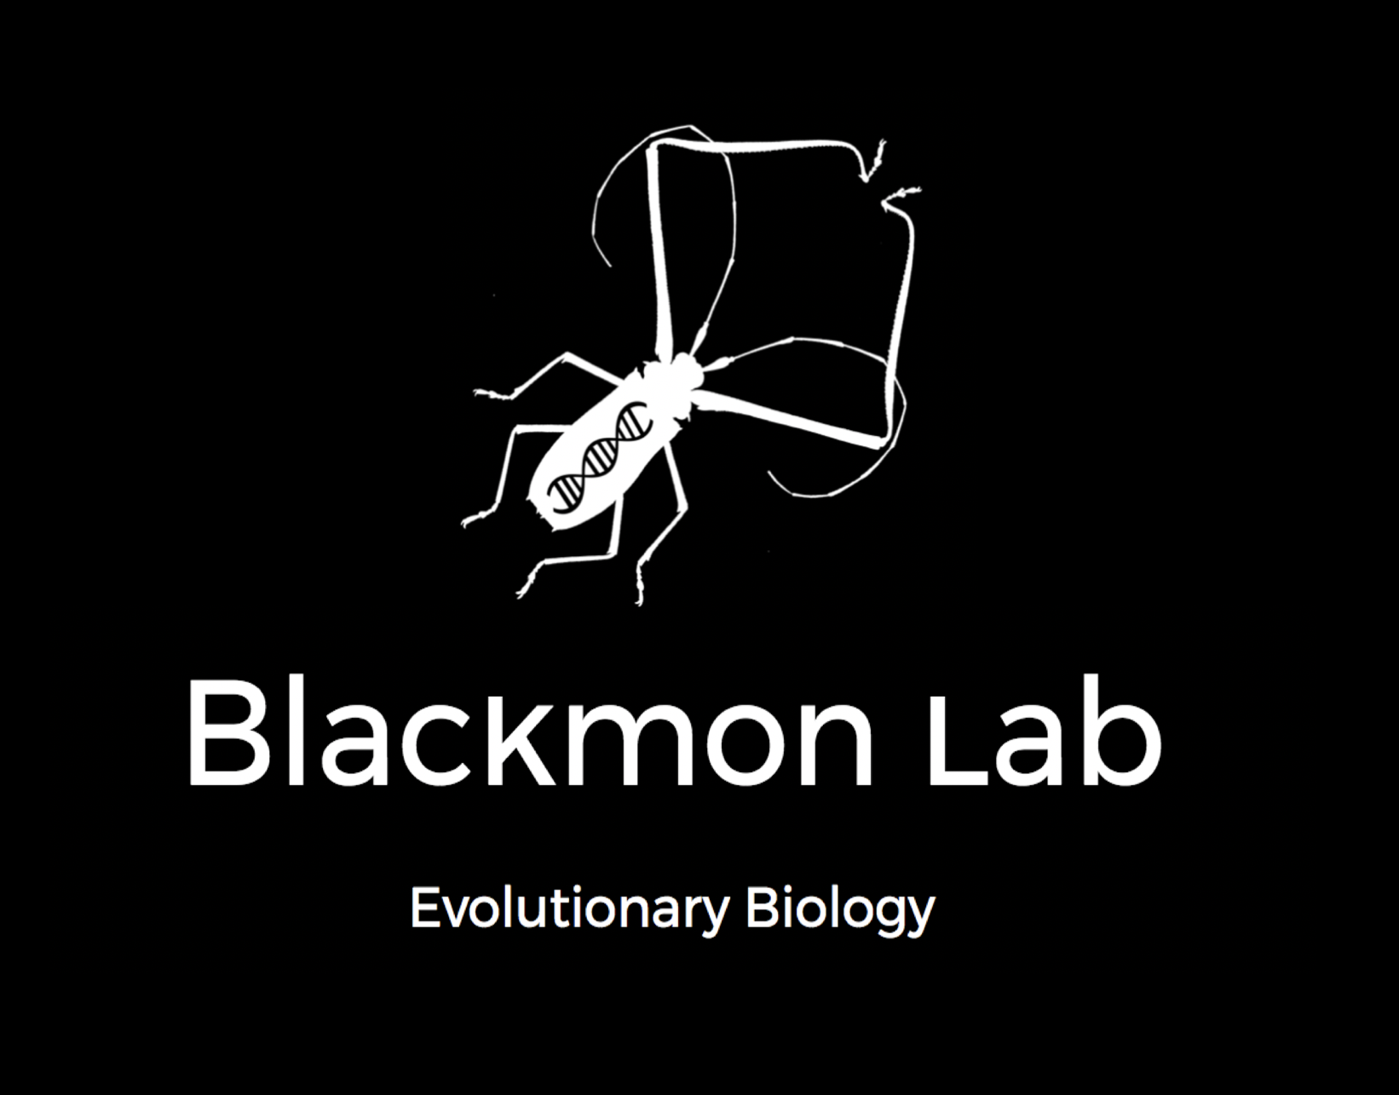

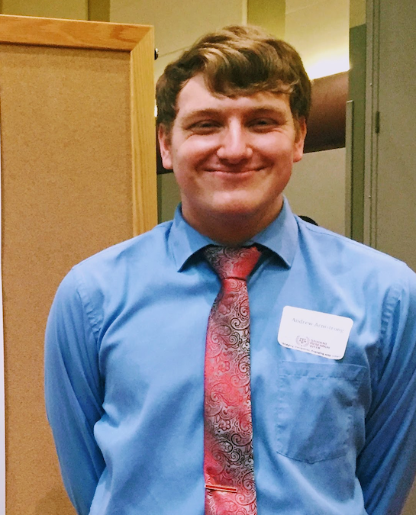






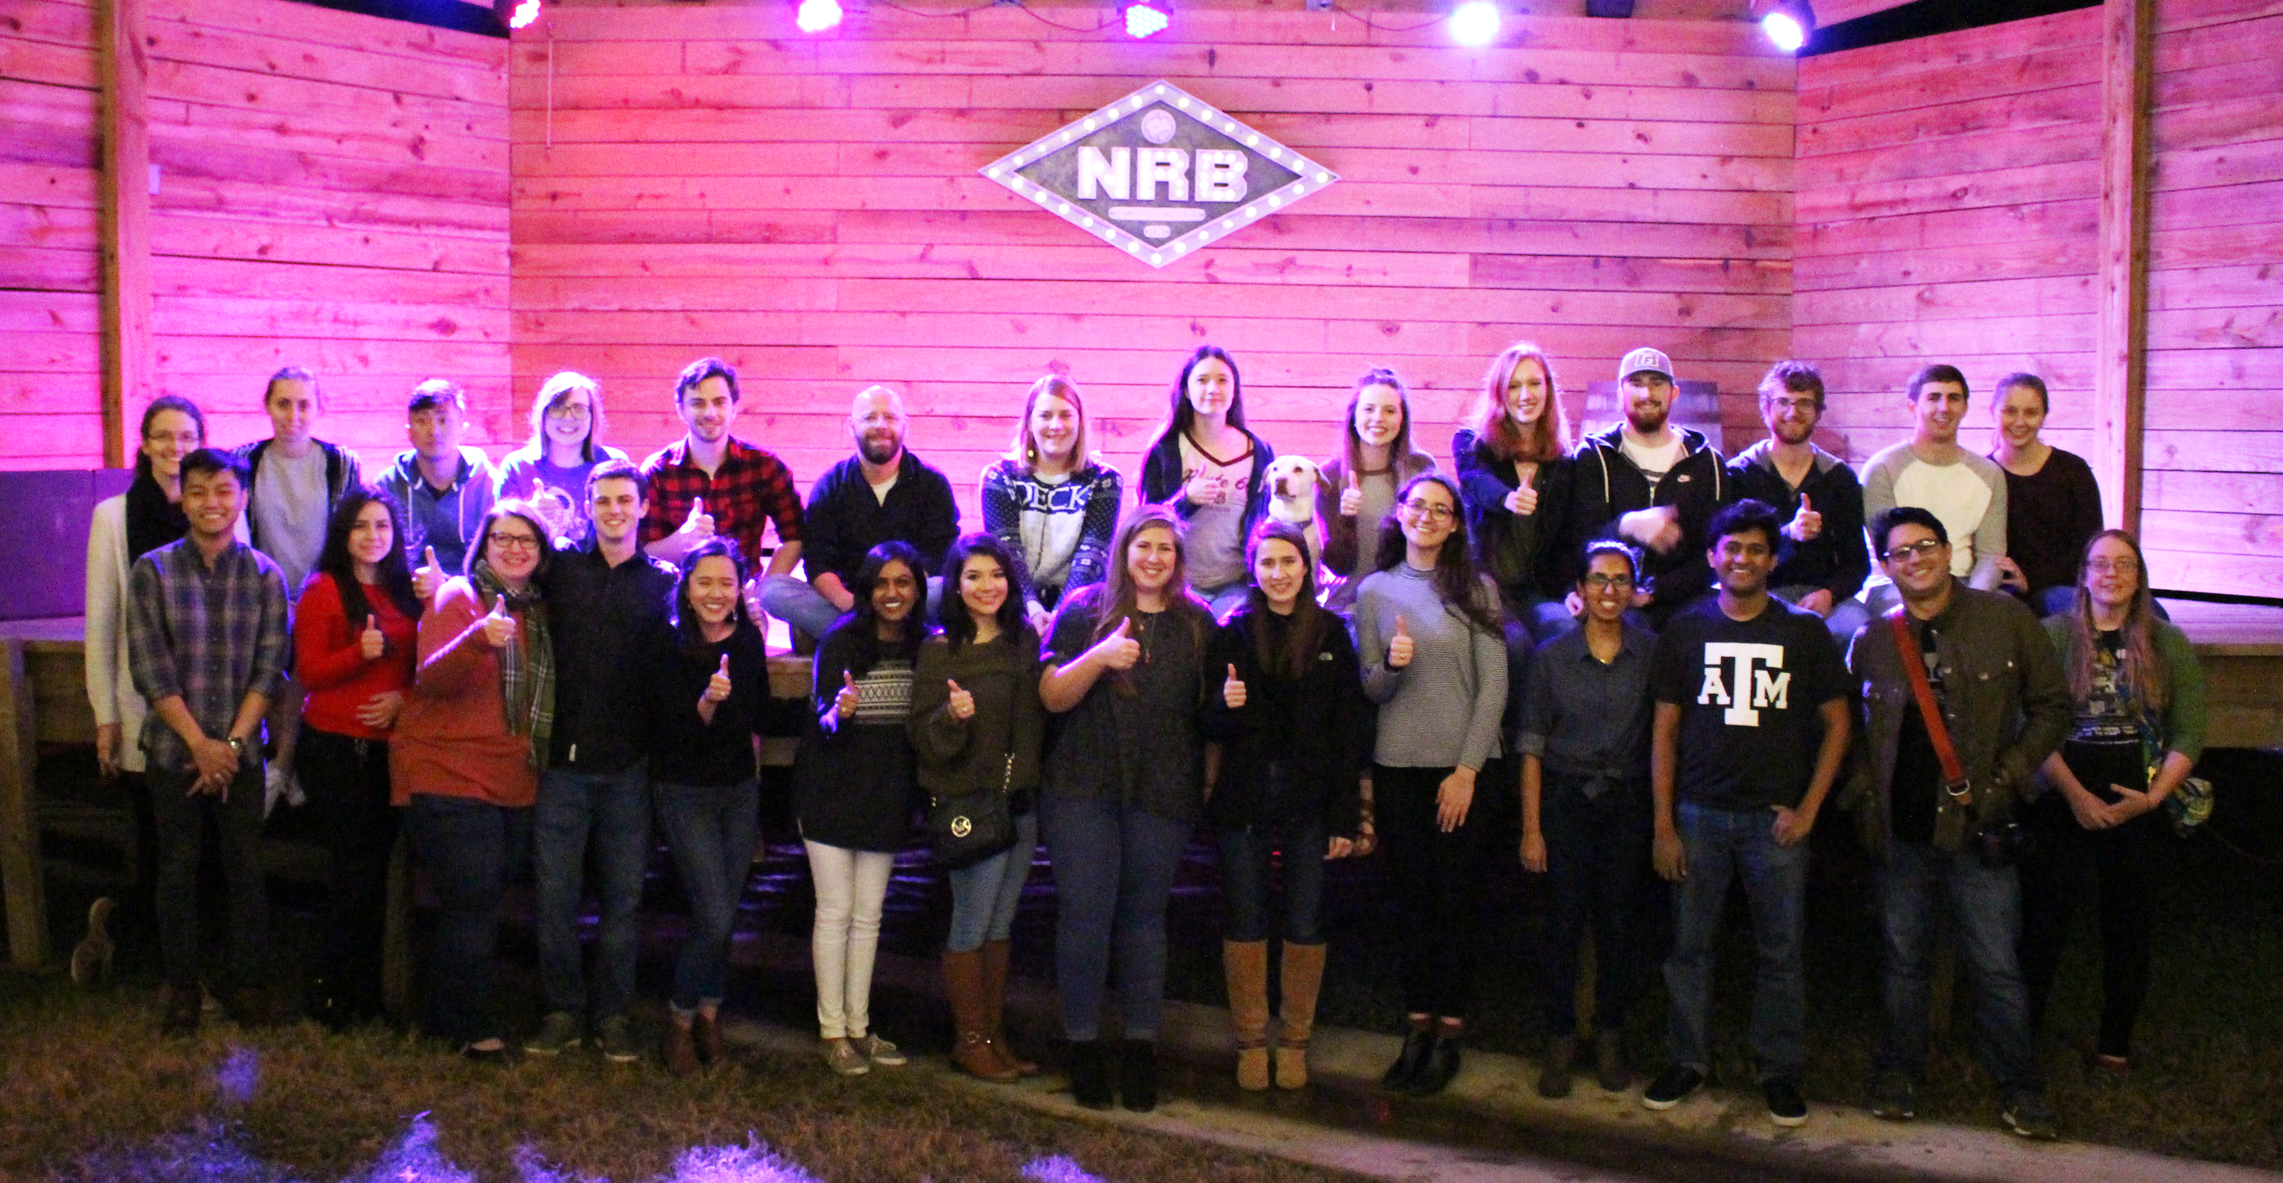

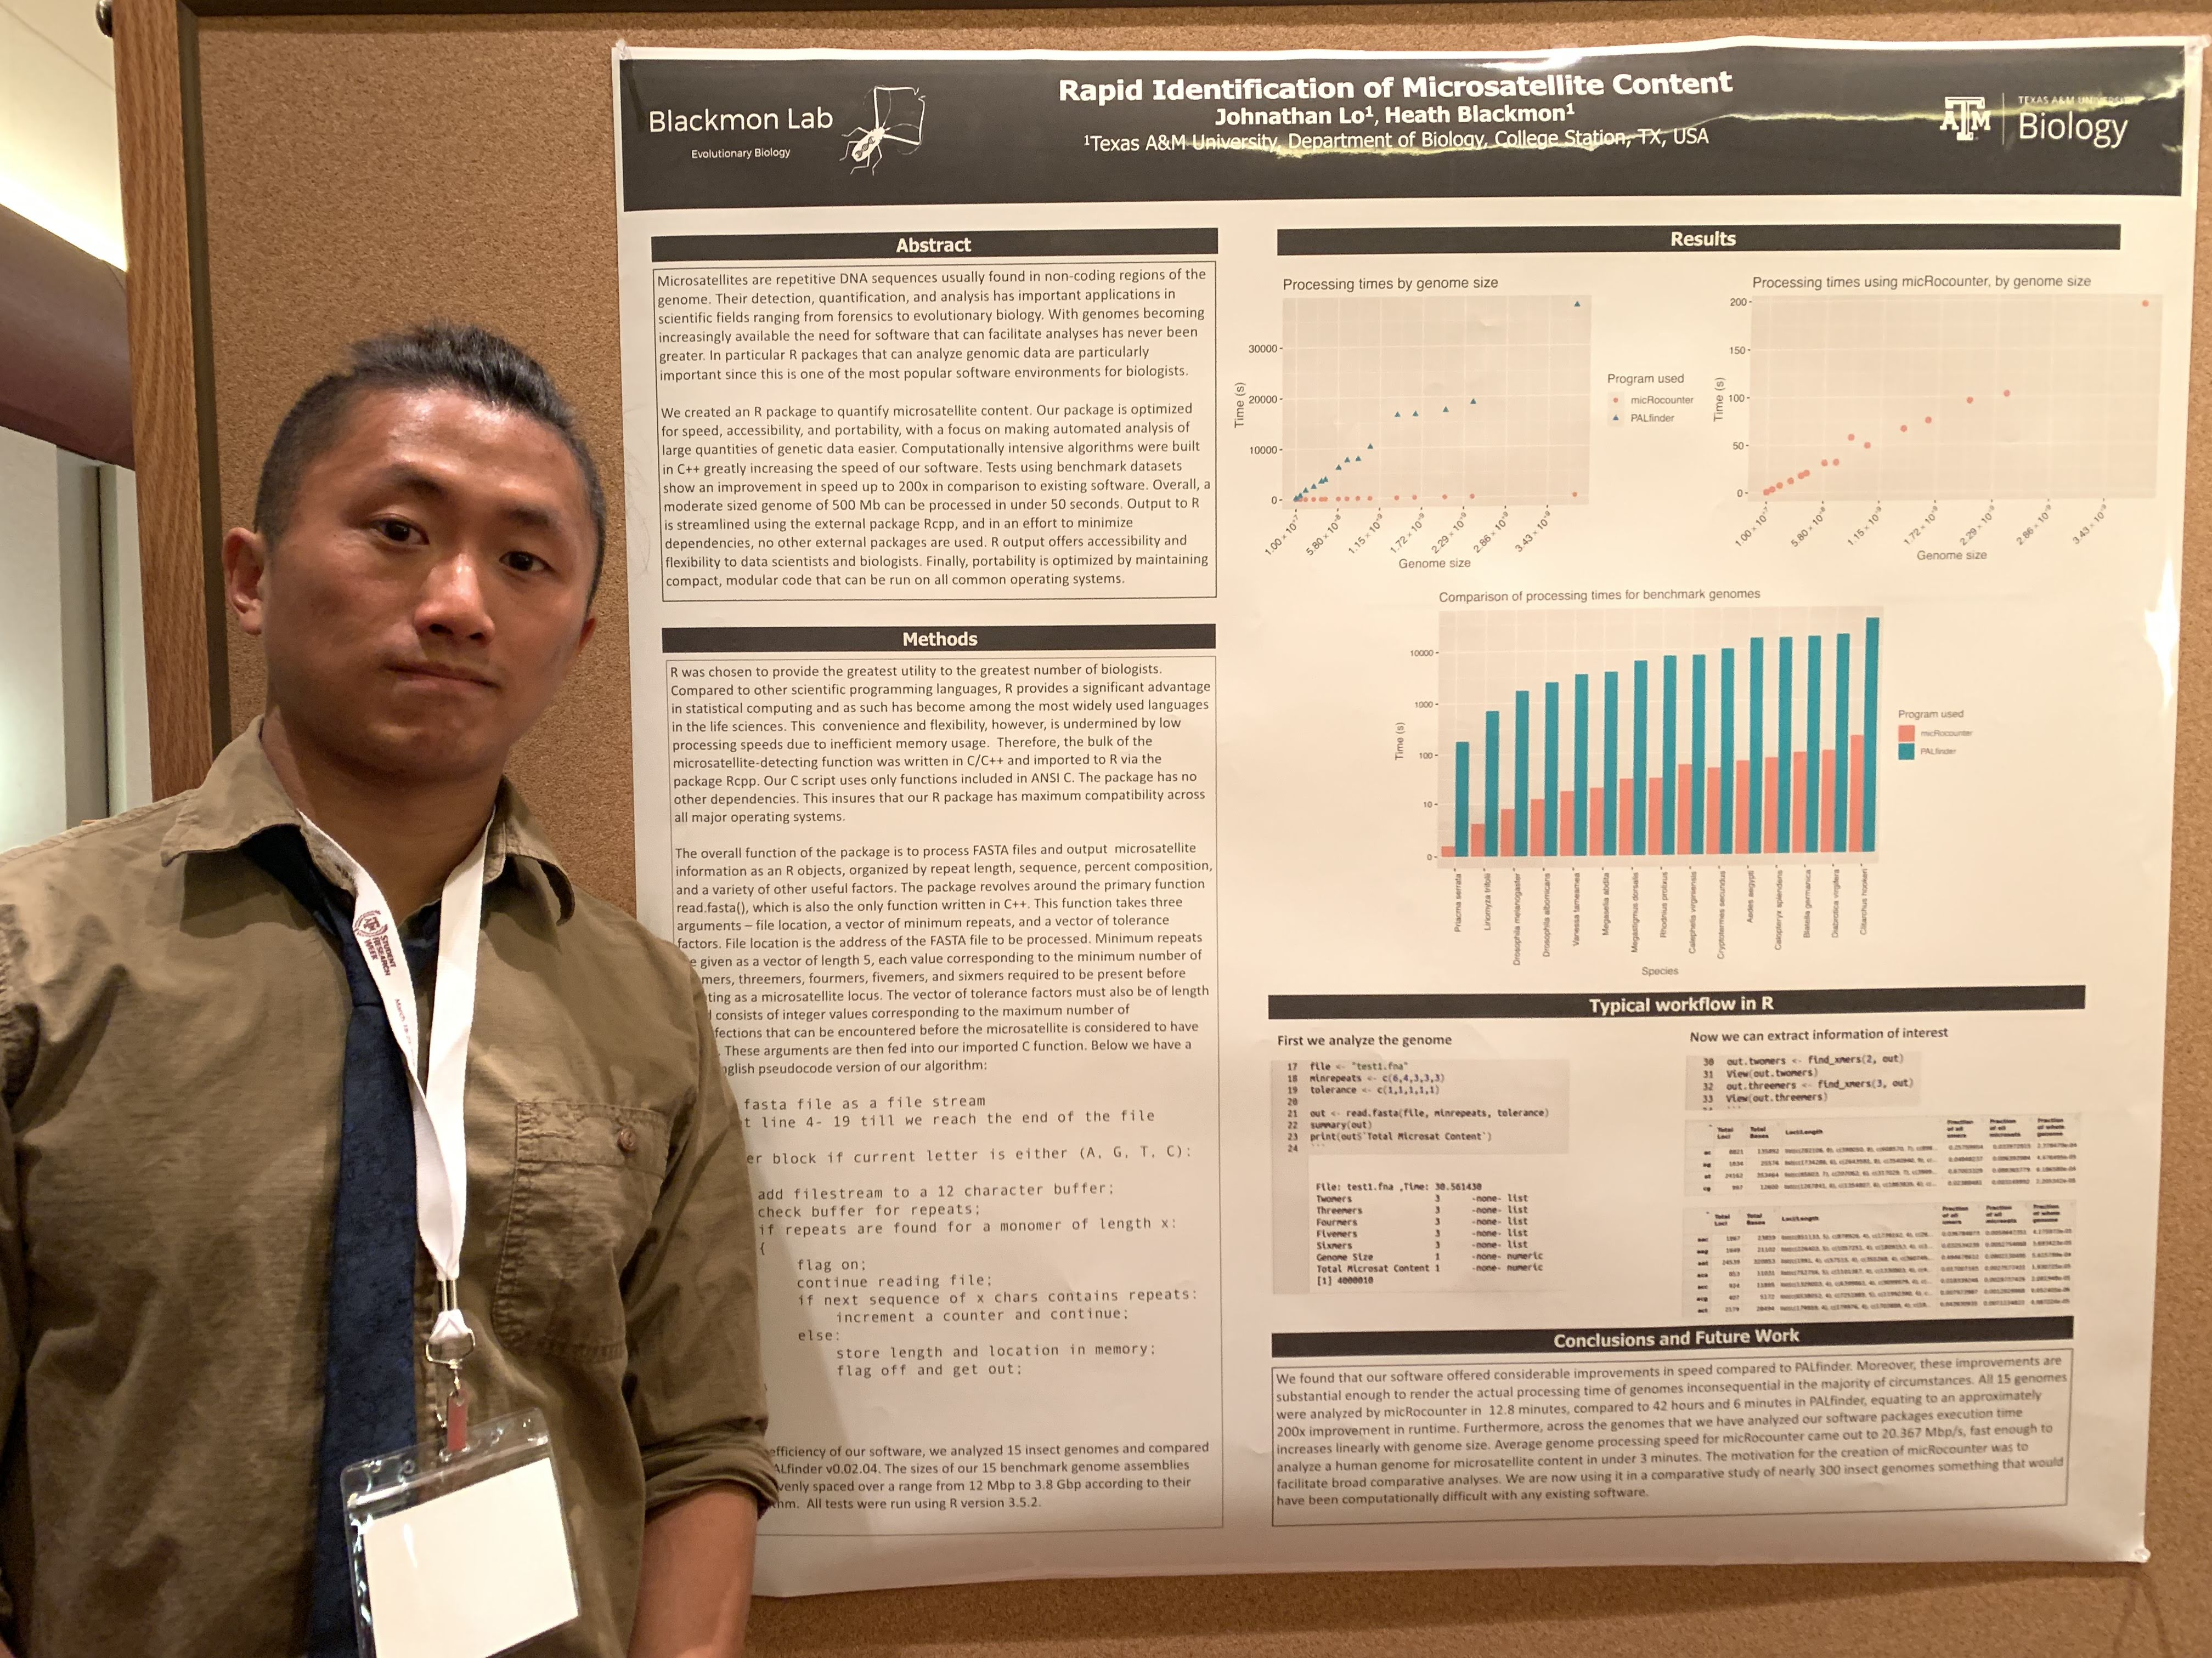

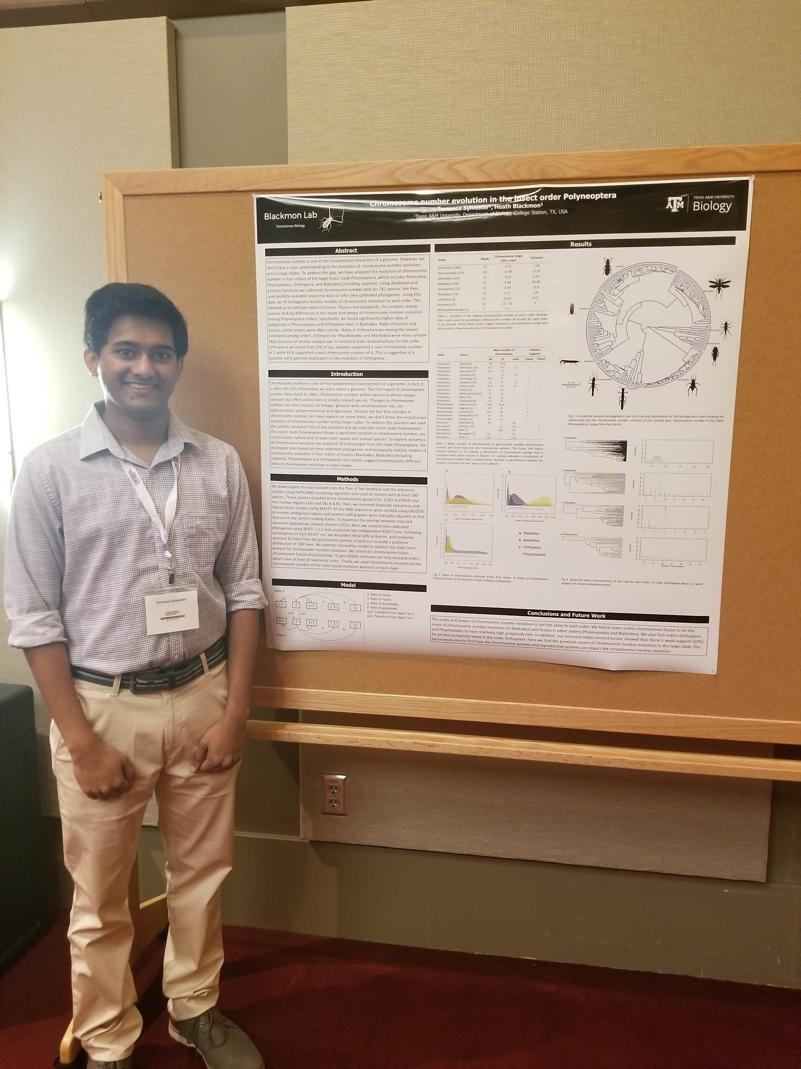
It takes a great team
LT Blackmon
Chief Field Assistant
Michelle Jonika
Grad Student
Andrew Armstrong
Undergrad
Paulina Serra Rossi
Undergrad
Riddhi Perkins
Lab Manager Extraordinaire
Julio Rincones Gamboa
Grad Student
Nathan Anderson
Undergrad
Amy Shum
Undergrad
Carl Hjelmen
Postdoc
Terrence Sylvester
Grad Student
Johnathan Lo
Undergrad
Ellie Simpson
Undergrad
And even more great people too!

